Slide 1

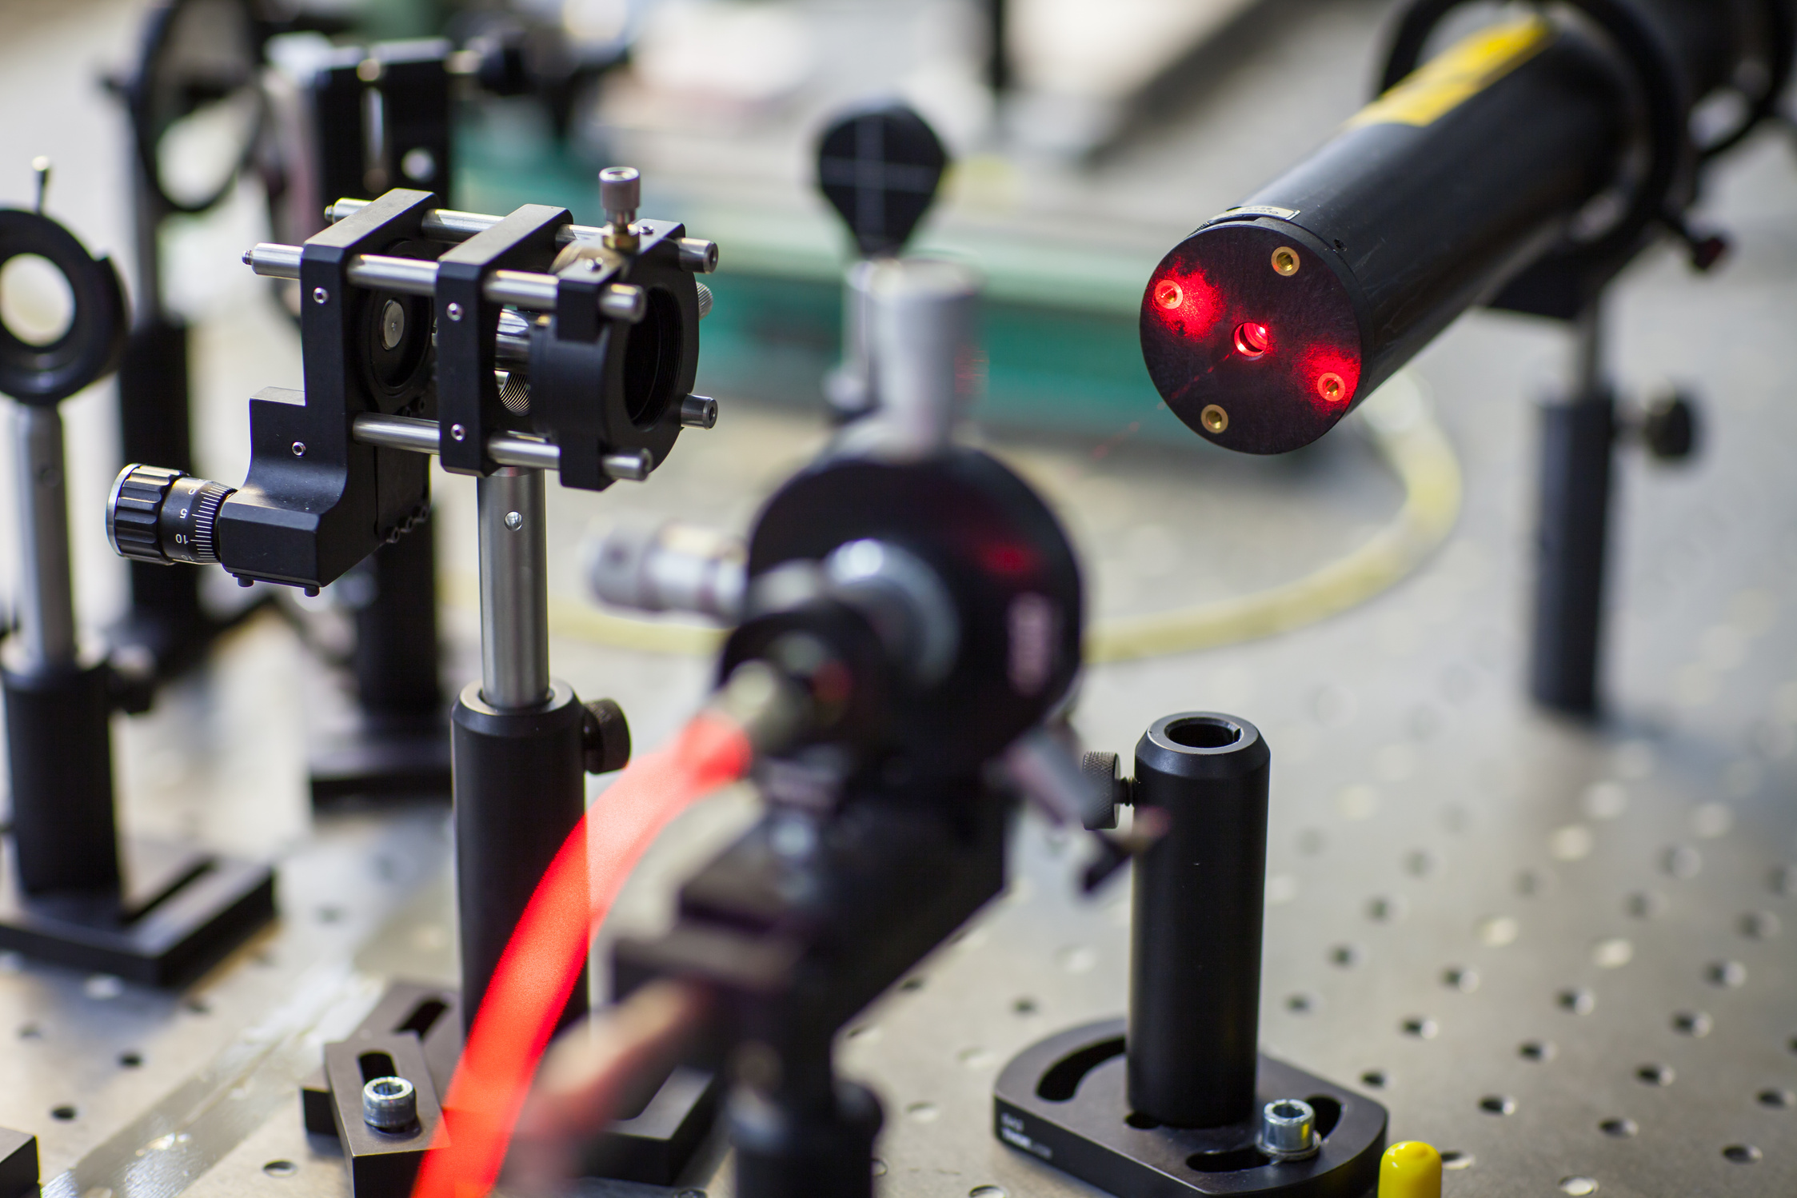


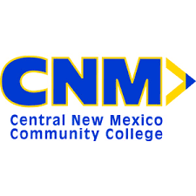
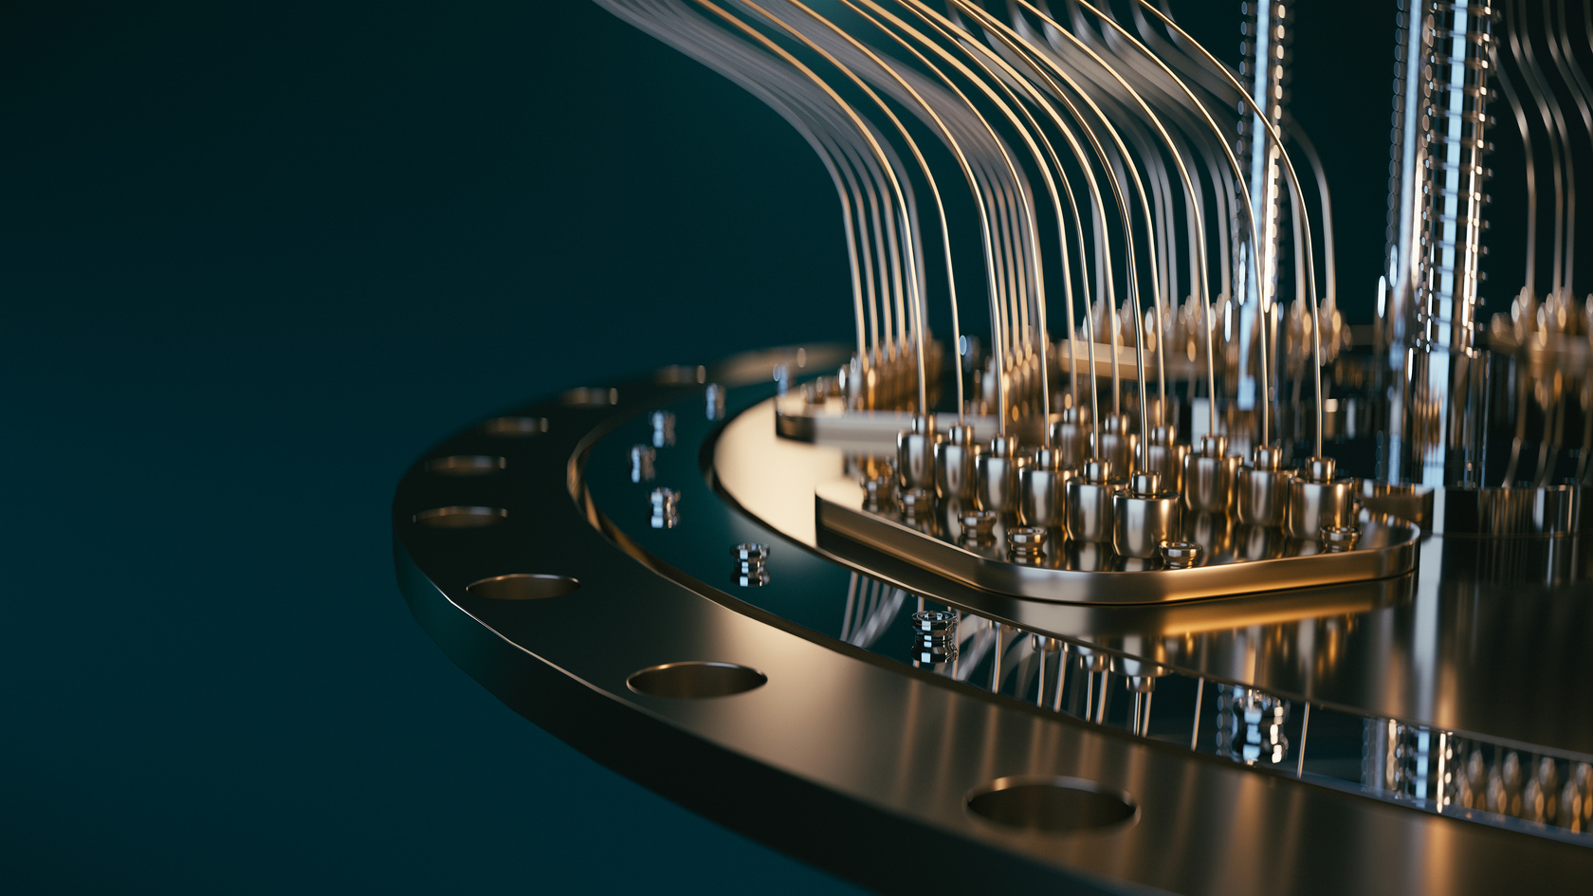

February 2025
Presented by Dr. Brian Rashap Ph.D
Quantum At CNM

Slide 2







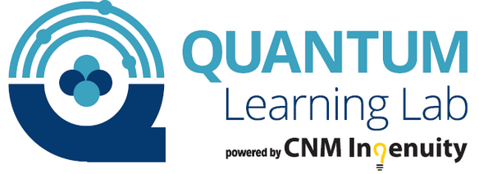
QuLL
WORKFORCE

Slide 3


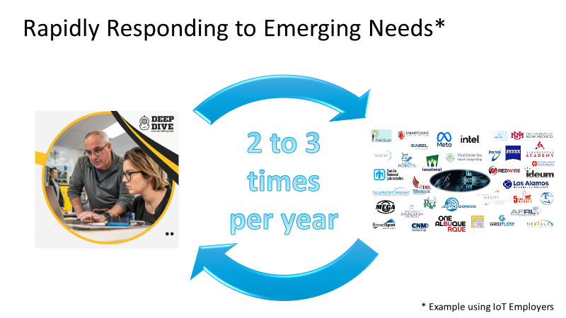
Rapidly Responding to Emerging Needs*
2 to 3 Times Per Year
*Example Using IoT Employers

Slide 4
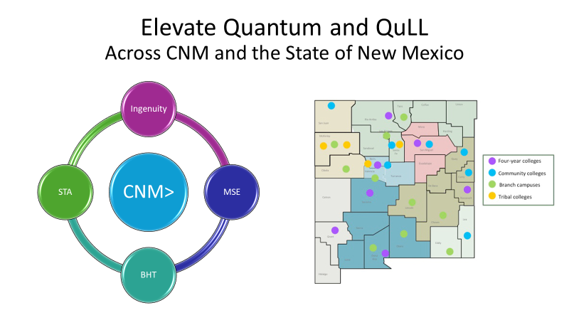
Elevate Quantum and QuLL
Across CNM and the State of New Mexico

Slide 5
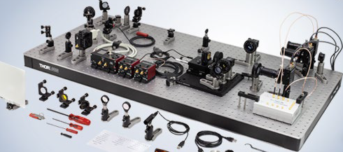

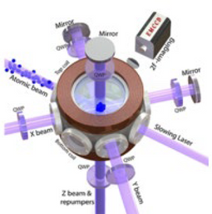
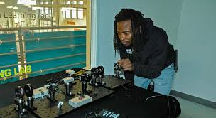
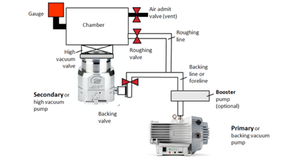
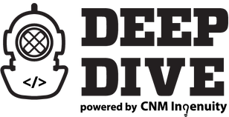
Quantum Learning Lab (QuLL)
Sandia National Labs and CNM Partnership
Training lab for Quantum Workforce Development located
at the FUSE Makerspace in downtown ABQ
Provide hands-on quantum experience for
Universitiy and Community College students
across the state
Enhance knowledge of early-stage
researchers and entrepreneurs
Immersive Hands-On Workforce Training (10 Weeks)
Built on the success of CNM Ingenuity’s Deep Dive Bootcamps
No Prior math/science needed
Focus On:
Optics and Photonics
Ultra-High Vacuum Systems
Quantum Phenomenon
Problem Solving, Documentation, Math, Statistics
Skills applicable to adjacent industries
semiconductor, Solar Cell, Opto-Electronic Manufacturing
CPL opportunities with Engineering Technician (and more)
Quantum Technician Bootcamp

Slide 6

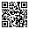
Thank You!
deepdivecoding.com/quantum/

